Slide 1

IOT BASED WHEELCHAIR FALL DETECTION
BATCH NO.13
AHMED USAMA 1604-18-739-018
SYED ISMAIL AHMED 1604-18-739-039
AHMED UZAIR 1604-17-739-046
GUIDE:PORP. MOHD.ABDUL MUQEET
DATE:31-12-2021

Slide 2
INTRODUCTION
One of the leading health problems in elderly is caused by falls. These falls, more often than not, have devastating consequences. While, full-time care is generally provided to fall-prone patients, it is not possible to anticipate and prevent falls all the time.
Falls in older persons are caused by underlying health impairments. They can be caused by some neuromuscular and sensory dis-functioning or also could be associated with fatigue, arthritis, dementia, diabetes, nutrition deficiency, anaemia, Arrhythmia, vision impairment, hearing impairment, disturbed ( higher or lower) body mass index, urinary issues, insomnia, cardiovascular diseases etc.

Slide 3
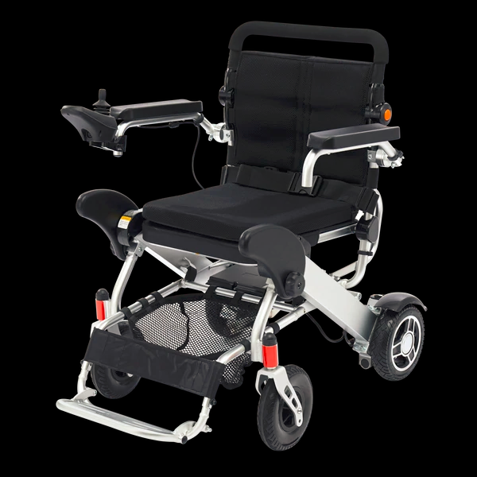
OBJECTIVE
The main aim of this project or application is to facilitate and increase the ability of disable people who can not function or move well. Using this wheel chair will allow handicapped people to move freely and independently without depending on others for their movement as a daily routine.

Slide 4
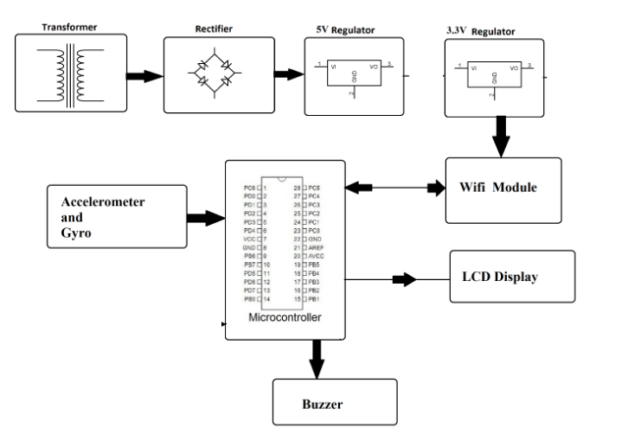
block diagram

Slide 5

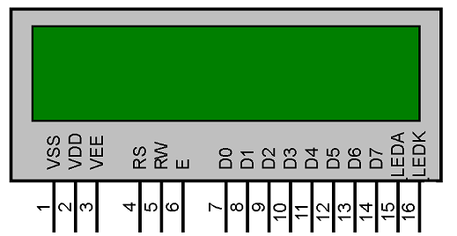
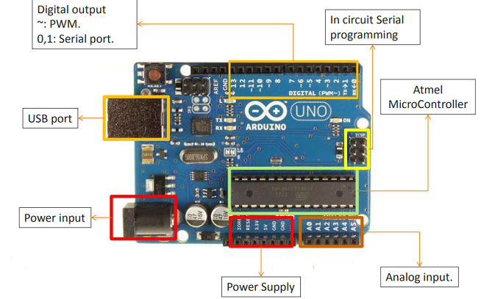
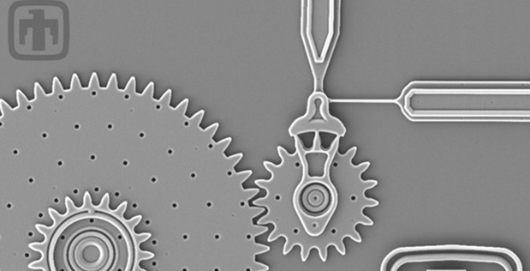
EQUIPENTS USED
Arduino
Power Supply
LCD
WIFI
Mems (accelerometer)

Slide 6
Arduino

Slide 7
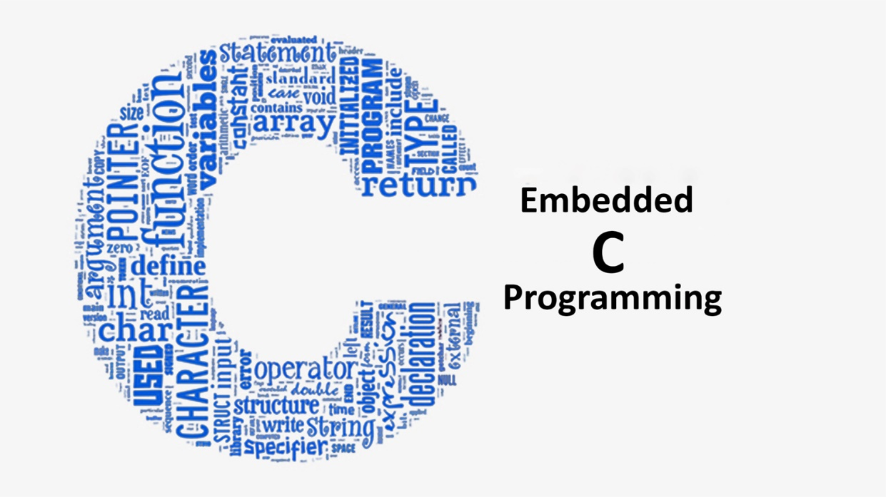
Software / IDE Using:
EMBEDDED C
KEIL U VISION

Slide 8
Advantages
To develop wheelchair system by using Visual Basic for wheelchair control.
Helps to implement movement for disabled people and aged people who can’t move properly.
Less Complexity and Hardware to mount.
Can be mounted on the existing wheelchair.

Slide 9
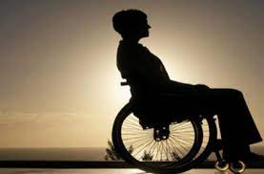
APPLICATIONS
HANDCAPPED PEOPLE
PATIENTS

Slide 10
Conclusions
The device can detect falls and direct much needed attention to the person. However, the device has to be further modulated and changed according to personal requirements. Furthermore, the device also needs to take into account other factors like different medical conditions of the person. The situation has attracted a lot of researchers and various researches are going on to determine a perfect way to detect and prevent falls. Using sensors mentioned in the paper is an approach that can be further enhanced to enhance the overall working of the system.

Slide 11


